Slide 1

Building and Mining Knowledge Graphs
(KEN4256)
Lecture 5: Knowledge Graph Quality

Slide 2
© 2024 by Michel Dumontier and the Institute of Data Science at Maastricht University is licensed under Attribution 4.0 International
To view a copy of this license, visit http://creativecommons.org/licenses/by/4.0/
This license requires that reusers give credit to the creator. It allows reusers to distribute, remix, adapt, and build upon the material in any medium or format, even for commercial purposes.
id: KEN4256_L5
version: 1.2024.0
created: February 17, 2019
last modified: March 26, 2024
published on: March 26, 2024

Slide 3
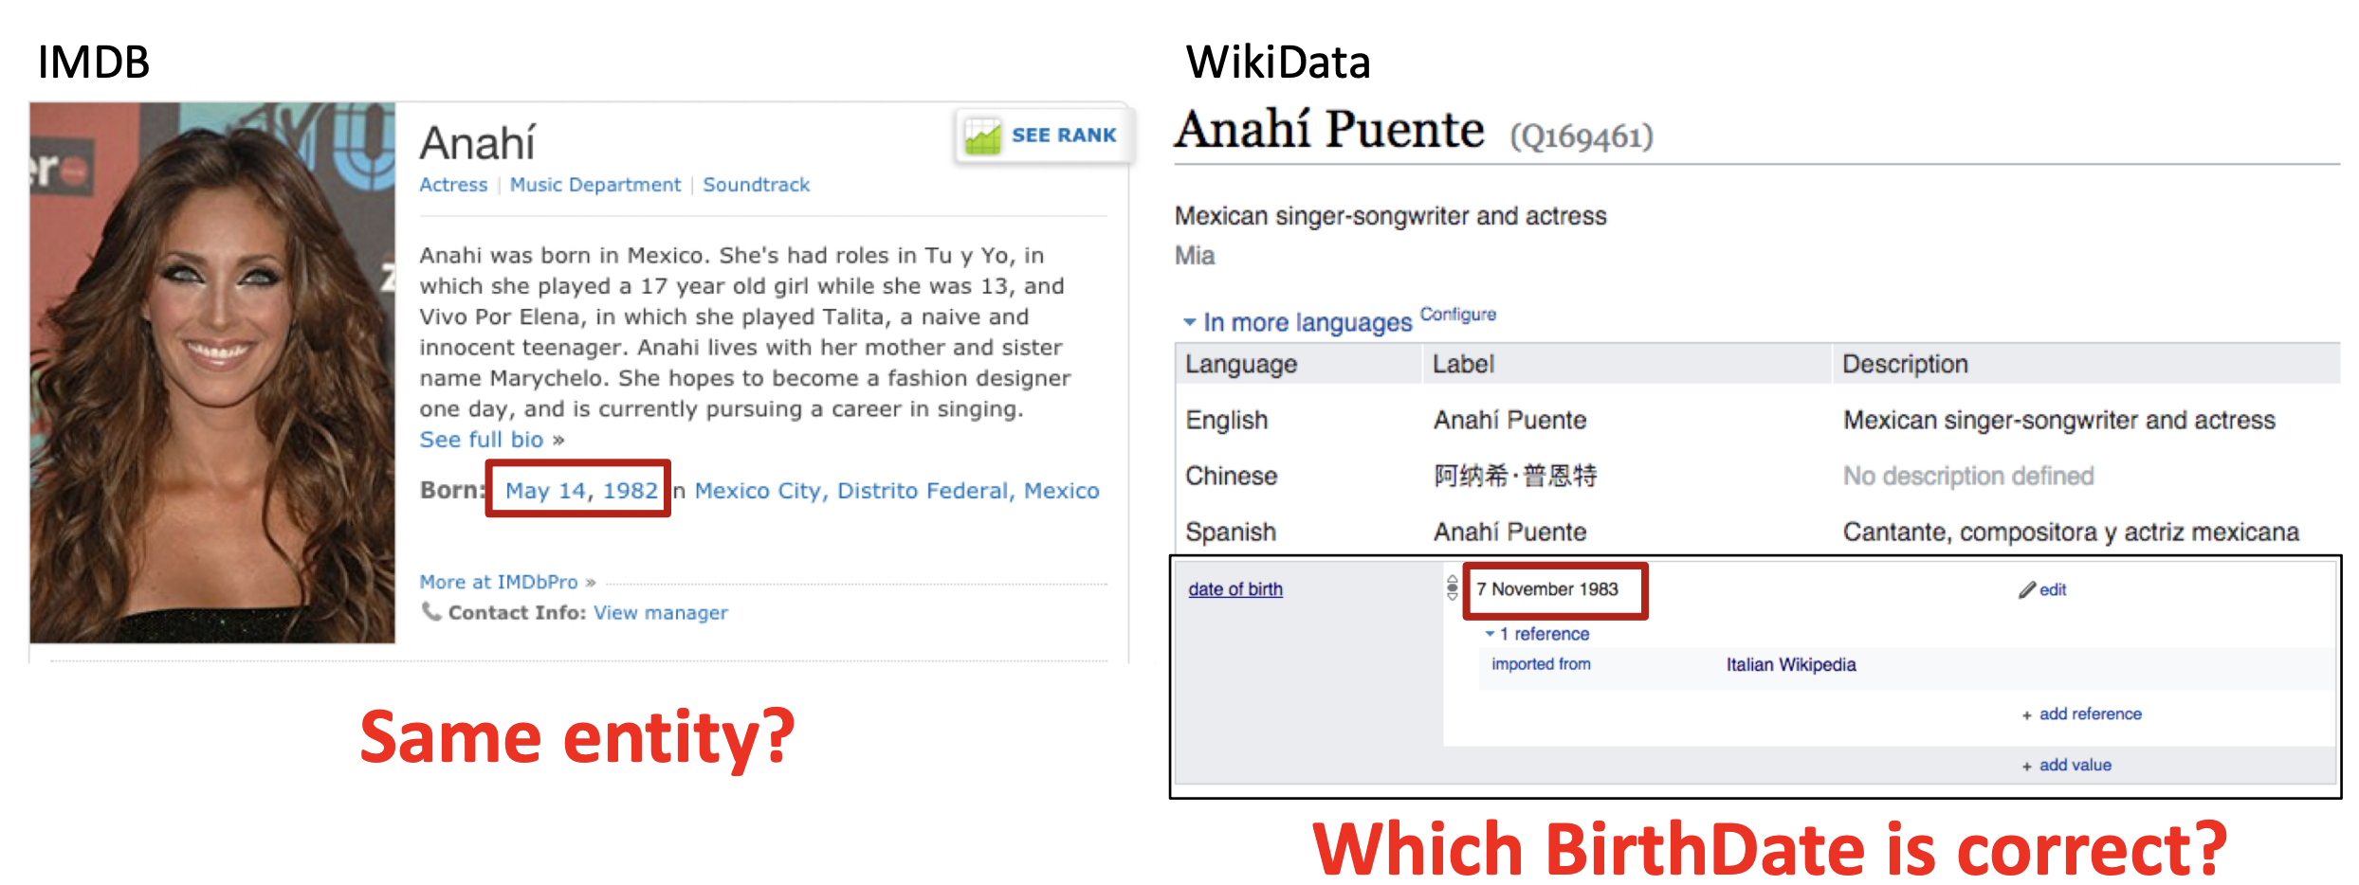
Quality issues in Data Integration

Slide 4
Data Quality Assessment & Goal
Goal: assess and ultimately improve the quality of a KG
Process: diagnose and fix data quality issues in a KG
Root cause analysis: identify source of quality issues
in the source data
arising due to data integration
incorrect use of vocabularies
linking data from untrustworthy sources

Slide 5
What is Data Quality?
Data Quality: a multi-dimensional concept with a popular definition ‘fitness for use’*.
*Juran et al., The Quality Control Handbook, 1974

Slide 6
Dimensions and metrics of Data Quality
Dimension: characteristics of a dataset.
Metric: procedure for measuring a quality dimension.

Slide 7
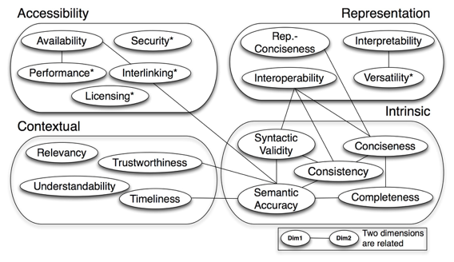
Data Quality Dimensions for KGs
Quality assessment for linked data: A survey. A Zaveri, A Rula, A Maurino, R Pietrobon, J Lehmann, S Auer. Semantic Web 7 (1), 63-93

Slide 8

KG Quality Dimensions - Accessibility
Availability: extent to which data is present, obtainable and ready for use
Metrics:
Check whether server responds to a SPARQL query
Check whether an RDF dump is provided and can be downloaded
Check whether the URI returns useful data (i.e. RDF)
Check whether all URIs contained within data are derefenceable.
Notes:
When an HTTP client can look up a URI using the HTTP protocol and retrieve a description of the resource, it is called a dereferenceable URI.

Slide 9
Availability: de-referenceability
proportion of URIs that return HTTP 200 and a valid HTML/RDF
Graph 1:
<http://examples.com/Vincent_van_Gogh> <http://dbpedia.org/ontology/birthPlace> <http://examples.com/Zundert> .
<http://examples.com/Vincent_van_Gogh> <http://examples.com/created> “Starry Night”^^xsd:string .
Graph 2:
<https://www.wikidata.org/wiki/Q5582> <http://dbpedia.org/ontology/birthPlace> <https://www.wikidata.org/wiki/Q9883> .
<https://www.wikidata.org/wiki/Q5582> <http://dbpedia.org/ontology/created> <https://www.wikidata.org/wiki/Q45585> .
Which graph has higher de-referenceability?

Slide 10
Availability: accessibility of endpoints
https://yummydata.org (uptime)
https://lod-cloud.net/datasets

Slide 11
KG Quality Dimensions - Accessibility
Interlinking: degree to which entities that represent the same concept are linked to each other, be it within or between two or more data sources or KGs
Metrics:
detection of the existence and use of external URIs (target dataset)
detection of all local in-links or back-links: all triples from a dataset that have the resource’s URI as the object
Notes:
When an HTTP client can look up a URI using the HTTP protocol and retrieve a description of the resource, it is called a dereferenceable URI.

Slide 12
Interlinking: internal
metric: degree - number of edges around a node
Graph 1:
<http://mygraph.org/America> <http://dbpedia.org/property/population> “330,000,000”^^xsd:integer .
<http://mygraph.org/Florida> <http://dbpedia.org/ontology/isPartOf> <http://mygraph.org/USA> .
Graph 2:
<http://mygraph.org/America> <http://dbpedia.org/property/population> “330,000,000”^^xsd:integer .
<http://mygraph.org/Florida> <http://dbpedia.org/ontology/isPartOf> <http://mygraph.org/USA> .
<http://mygraph.org/America> <http://www.w3.org/2002/07/owl#sameAs> <http://mygraph.org/USA> .
Which graph has higher degree of interlinking?

Slide 13
Interlinking: external
metric: number of sameAs chains
Graph 1:
<http://mygraph.org/America> <http://dbpedia.org/property/population> “330,000,000”^^xsd:integer .
<http://mygraph.org/Florida> <http://dbpedia.org/ontology/isPartOf> <http://mygraph.org/USA> .
Graph 2:
<http://mygraph.org/America> <http://dbpedia.org/property/population> “330,000,000”^^xsd:integer .
<http://mygraph.org/Florida> <http://dbpedia.org/ontology/isPartOf> <http://mygraph.org/USA> .
<http://mygraph.org/America> <http://www.w3.org/2002/07/owl#sameAs> <http://geonames.org/country/USA> .
External graph:
<http://geonames.org/country/USA> <http://geonames.org/property/area> “9, 834, 000”^^xsd:double .
Which graph has higher degree of interlinking?

Slide 14
Data Quality Dimensions for KGs
Quality assessment for linked data: A survey. A Zaveri, A Rula, A Maurino, R Pietrobon, J Lehmann, S Auer. Semantic Web 7 (1), 63-93

Slide 15

KG Quality Dimensions - Intrinsic
Syntactic Validity: degree to which an RDF document conforms to the specification of the serialization format.
Metrics:
(i) syntactic rules (type of characters allowed and/or the pattern of literal values)
(ii) use of explicit definition of the allowed values for a datatype
Process:
detecting syntax errors using (i) validators, (ii) via crowdsourcing
Example:
Literals (e.g. date) are tagged with appropriate data type.

Slide 16

KG Quality Dimensions - Intrinsic
Semantic Accuracy: The degree to which data has attributes that correctly represent the real-life phenomena.
Metrics:
no incorrect values
no misuse of properties
no inaccurate annotations, labellings or classifications
outliers
Example:
ex:John schema:age “-1”^^xsd:integer
Notes:
Do we have GDP for ALL countries?

Slide 17

KG Quality Dimensions - Intrinsic
Consistency: The degree to which data is consistent with (has no violation) semantic rules defined.
Metrics:
correct domain and range definition
no misplaced classes or properties
Example:
ex:John :drives ex:Tesla .
ex:Tesla rdf:type Person .
Notes:
Do we have GDP for ALL countries?

Slide 18

KG Quality Dimensions - Intrinsic
Completeness: degree to which all required information is present in a particular dataset.
Metrics:
Schema - ontology completeness (do we have types for all entities?)
Property - missing values for a specific property?
Population - % of all real-world objects of a particular type
Interlinking - degree to which instances in the dataset are interlinked
Example:
Does the KG have the GDP for all countries, and all years?
Notes:
Do we have GDP for ALL countries?

Slide 19

KG Quality Dimensions - Intrinsic
Conciseness: degree to which the irrelevant and duplicate schema and data elements are avoided.
Metrics:
Intensional conciseness - refers to the case when the data set does not contain redundant schema elements (properties and classes). Only essential properties and classes are included in the schema;
Extensional conciseness -refers to the case when the data set does not contain redundant objects (instances).
Example:
ex:NL rdfs:label “Netherlands”
ex:NL schema:name “Netherlands”
Notes:
Do we have GDP for ALL countries?

Slide 20
Which data quality issues do you see in the given RDF snippet?
@prefix ex: <http ://example.org/ontology/> .
ex:Italy ex:hasCapital ex:Milan.
ex:Italy ex:areaTotal ‘‘301338’’^^xsd:string .
ex:Italy rdfs:name “Italy”@en
ex:Italy ex:hasCapital ex:Rome.
ex:Rome a :Place.
:hasCapital rdfs:domain :Country .
:hasCapital rdfs:range :City.

Slide 21
Data Quality Dimensions for KGs
Quality assessment for linked data: A survey. A Zaveri, A Rula, A Maurino, R Pietrobon, J Lehmann, S Auer. Semantic Web 7 (1), 63-93

Slide 22

KG Quality Dimensions - Contextual
Trustworthiness: degree to which the information is accepted to be correct, true, real and credible.
Metrics:
Does the KG contain triples that capture the provenance of each assertion (triples)? Who, when, where, how?
Does it use provenance specifying schemas/ontologies (PROV-O, HCLS)
Majority vote / opinion-based method: how many KG contributors have annotated this assertion / triple to state that they trust it?

Slide 23
KG Quality Dimensions - Contextual
Trustworthiness: degree to which the information is accepted to be correct, true, real and credible.
:assertion { ex:trastuzumab ex:is-indicated-for ex:breast-cancer . }
:provenance { :assertion prov:generatedAtTime "2012-02-03T14:38:00Z"^^xsd:dateTime . :assertion prov:wasDerivedFrom :experiment . :assertion prov:wasAttributedTo :experimentScientist . }

Slide 24
Data Quality Dimensions for KGs
Quality assessment for linked data: A survey. A Zaveri, A Rula, A Maurino, R Pietrobon, J Lehmann, S Auer. Semantic Web 7 (1), 63-93

Slide 25

KG Quality Dimensions - Representational
Interoperability - degree to which the format and structure of the information conforms to previously returned information as well as data from other sources.
Metrics:
Reuse of well known vocabularies
Example:
ex:myKG ex:hasProvenance <https://d2s.semanticscience.org> .
vs
ex:myKG prov:wasGeneratedBy <https://d2s.semanticscience.org> .

Slide 26
Tools for KG
Quality Assessment

Slide 27
SPARQL
SPARQL can be used to verify data quality issues.
RDF Graph
ex:ValidCountry a ex:Country ;
ex:germanLabel "Spanien"@de .
ex:InvalidCountry a ex:Country ;
ex:germanLabel "Spain"@en .
SPARQL
SELECT ?this (ex:germanLabel AS ?path) ?value
WHERE {
?this ex:germanLabel ?value .
FILTER (!isLiteral(?value) || !langMatches(lang(?value), "de"))
}

Slide 28
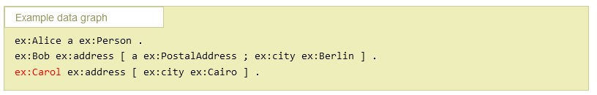
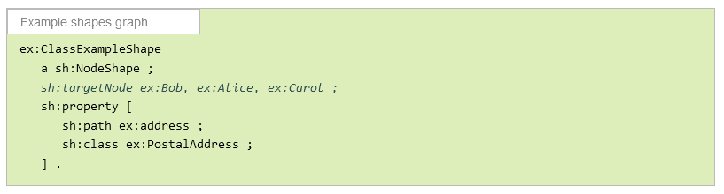
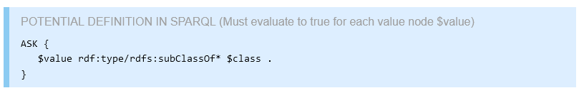
SHACL
W3C Standard to validate RDF graphs.
SHACL offers a syntax to readily construct RDF constraints, and these can be implemented as SPARQL queries.
Some tools exist to construct and validate SHACL rules
https://shacl-play.sparna.fr/play/
https://shacl.org/playground/
https://forms.hypermedia.app/playground/
https://www.itb.ec.europa.eu/shacl/any/upload
SHACL conformance can be spotty, so check the test suite:

Slide 29
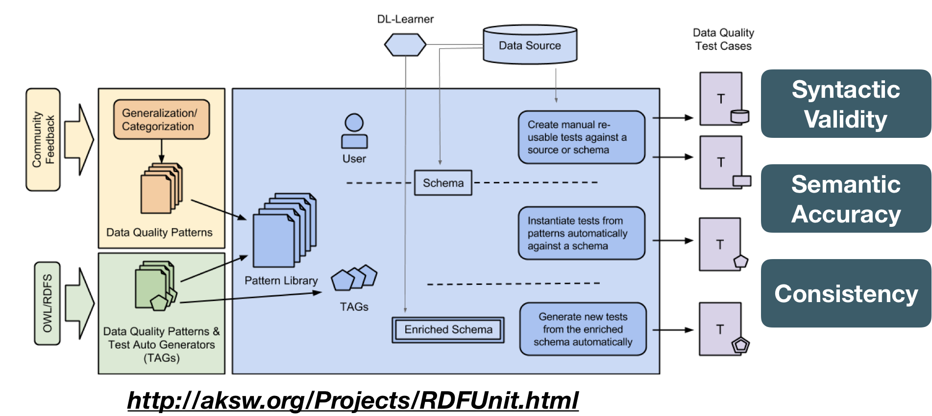
DQA Tool - RDFUnit
Notes:
https://aksw.org/Projects/RDFUnit.html

Slide 30
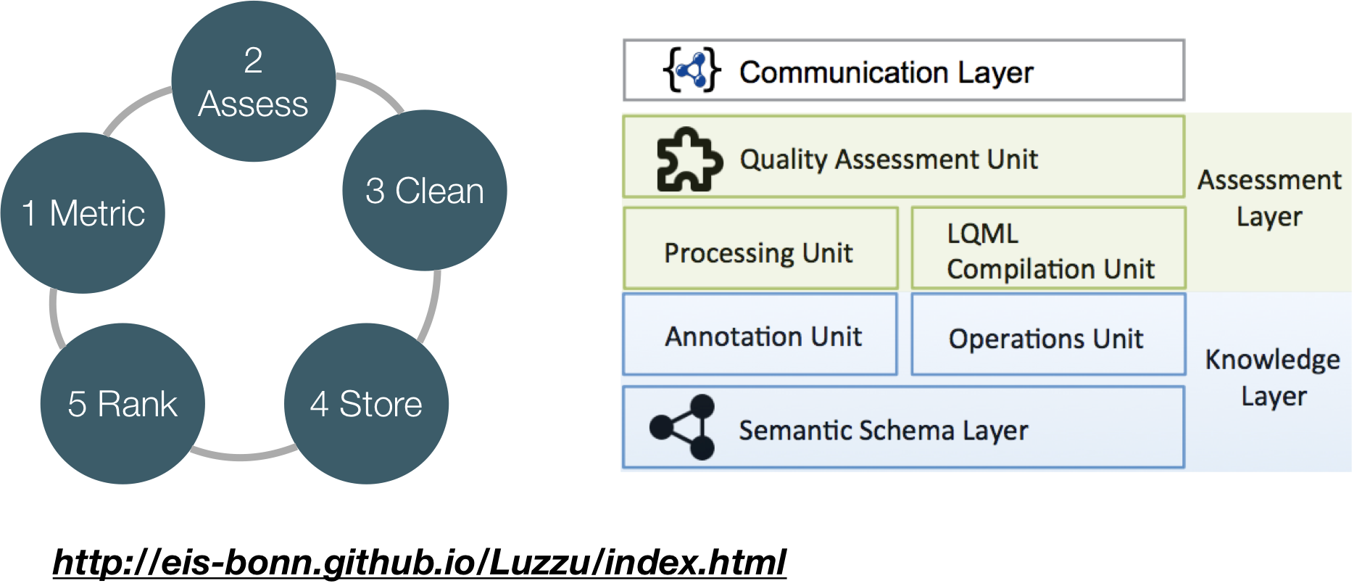
DQA Tool - Luzzu
http://eis-bonn.github.io/Luzzu/index.html

Slide 31

DQA Tool - Shape Expressions
Shape Declaration
Shape Validation
PREFIX : <http://example.org/> PREFIX schema: <http://schema.org/> PREFIX xsd: <http://www.w3.org/2001/XMLSchema#>
:User { schema:name xsd:string ; schema:birthDate xsd:date? ; schema:gender [schema:Male
schema:Female ]
OR xsd:string ; schema:knows IRI @:User* }
alice schema:name "Alice" ; # Passes as a :User schema:gender schema:Female ; schema:knows :bob . :bob schema:gender schema:Male ; # Passes as a :User schema:name "Robert"; schema:birthDate "1980-03-10"^^xsd:date .
:dave schema:name "Dave"; # Fails as a :User schema:gender "XYY"; schema:birthDate 1980 . # 1980 is not an xsd:date *)

Slide 32
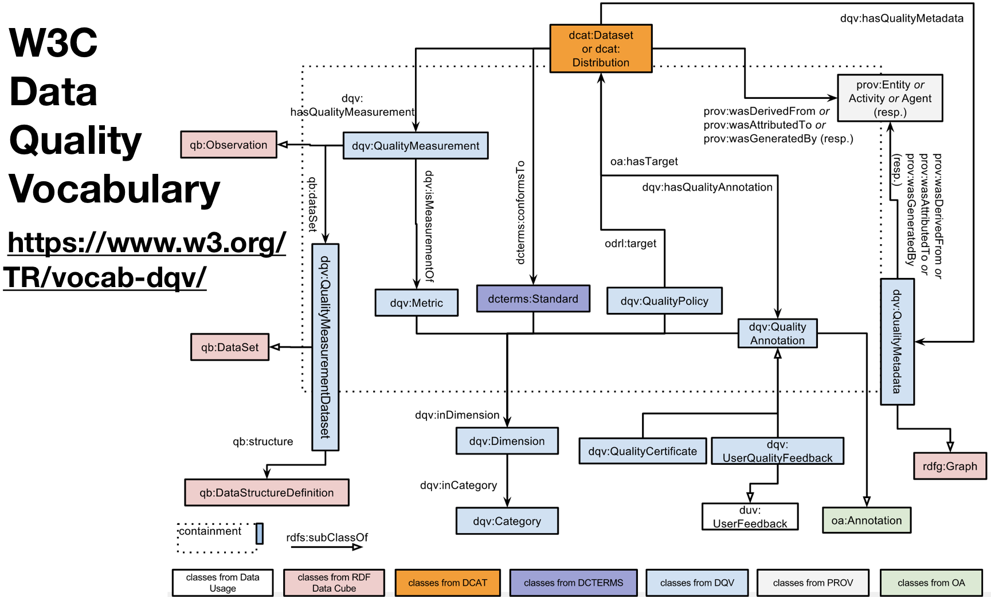
https://www.w3.org/tR/vocab-dqv
Notes:
After you run DQ assessments on KGs, you can report the results in a KG and you can use the DQV to describe the results of your assessment.

Slide 33
Summary
Data (KG) quality has important social and financial consequences because the data in KGs drive applications for decision-making.
Data (KG) quality is a vast research area studying various dimensions and aspects of data quality.
Each dimension of quality can be assessed and measured using standard or KG engineer-specified metrics.
Software tools can assist in automated assessment of data quality. However, it can also be performed semi-automatically with machines in combination with humans (e.g. crowdsourcing)
Data quality assessment can improve the quality of your KGs, which in turn improves the trustworthiness of any analyses and systems built on top of these KGs.

